Slide 1
Snapshot survey 2019 critical limb ischaemia
BSIR R&A COmmittee
Dr Victoria Burrows MBChB FRCR
ST5 IR Sheffield Teaching Hospitals

Slide 2
Background
“A Best Practice Clinical Care Pathway for Peripheral Arterial Disease” March 2019
Vascular Surgery GIRFT 2018
  Inconsistency across the UK
  Universally unacceptable pathway delays
  Evidence based, multidisciplinary care pathways
Notes:
Vascular soceity published quality improvement framework
In response to recommendations made in
In terms of service provision, hospital stays and patient outcomes
Wanted to develop..

Slide 3

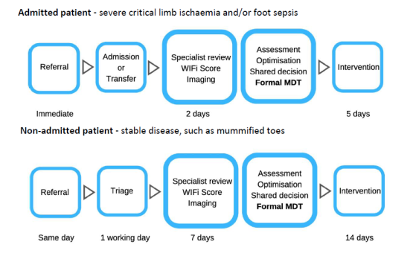
Background

Slide 4
Method
Preliminary survey
Snapshot daily survey
Regular reminders
Notes:
Using Survey monkey and via BSIR mailing list
Prelim – 25/9
Snapshot 7-13th Oct

Slide 5
Results – Preliminary Survey

Slide 6
Results – Preliminary Survey

Slide 7
Results – Preliminary Survey

Slide 8
Results – Preliminary Survey

Slide 9
Results – procedures performed
Notes:
Total of 30 cases
5 OOH 25 in hours

Slide 10
Results – method of referral
Notes:
Other – vasc clinic, written ref with no discussion, ad hoc discussion
Formal scoring used in 2 ref – 1 x Wifi, 1 x Fontaine

Slide 11
Results – imaging performed

Slide 12
Results – procedures performed

Slide 13
Results – Daily Survey
Notes:
Admit to procedure mean 9.8 days (0 – 57)
Admit to decision mean 1.8 days (0 - 9)
Decision to treatment mean 8 days (0 – 57)

Slide 14
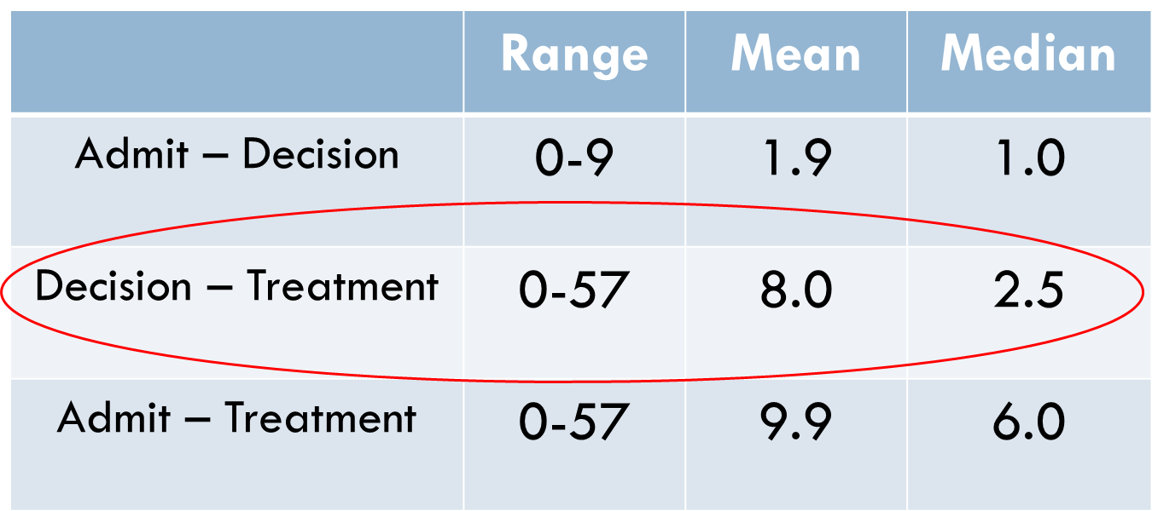
Results – all patients (30)

Slide 15
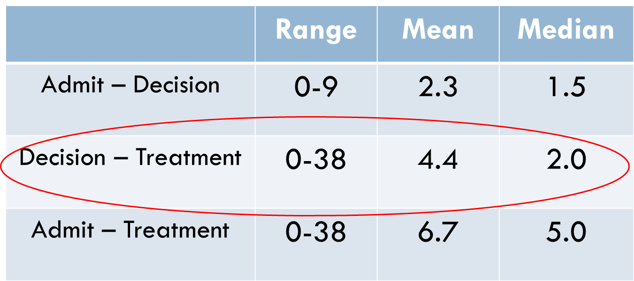
Results – IP (24)

Slide 16
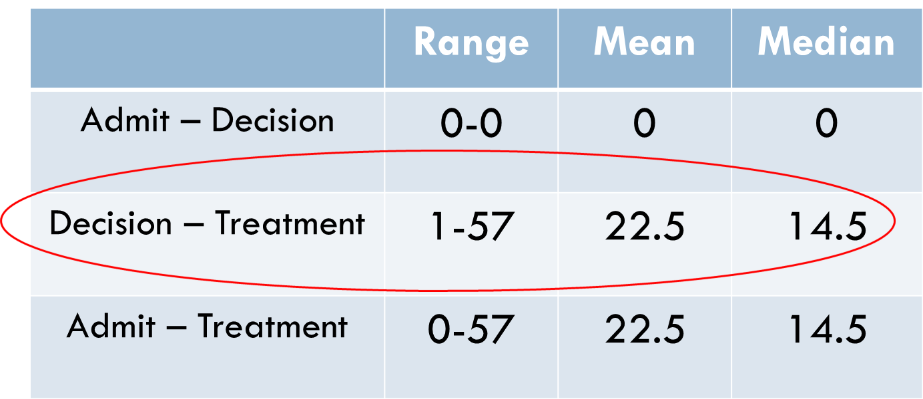

Results - OP (6)
Notes:
Ad – Dec:
Mode 1.8 (0-9)
Median 1
Dec – Pro:
Mode 8 (0-57)
Median 2.5
Ad – Pro:
Mode 9.8 (0-57
Median 6

Slide 17
Results – delays
Notes:
Some cases had more than one reason for delay
Specialist blood type, planned around dialysis, long waiting lists for “stable CI”, night pain only, prolonged transfer from spoke hospital waiting for bed

Slide 18
Results – IP delays
7 no delay
5 room availability
3 consultant availability
2 anticoagulation
1 anaesthetic availability
1 MDT/planned around dialysis
1 specialist blood type

Slide 19
Results – OP delays
3 no delay
2 outpatient waiting lists for “stable” disease
1 anticoagulation

Slide 20
Results – operator of procedure

Slide 21
Results – presence of consultant

Slide 22
Conclusions
Imaging
Referrals
Scoring
Treatment time:
  variable
  decision – treatment longest
  median cases – at or nearly at targets
Delays:
  multifactorial
  consultant and room availability
Notes:
Multifactorial but that room, IR avail, MDT decision and anti coags all play their role

Slide 23
Future work
NVR – encourage trainees to help
Local audit:
  Cambridge
  Gloucestershire
  Hull and East Yorkshire
  North Bristol
  Royal Bournemouth and Christchurch
  Royal Liverpool and Broadgreen
  St George’s
  The Dudley Group
  University Hospitals Birmingham
  University Hospitals of Leicester
  York Teaching Hospitals
Notes:
To see if any national trends
Local audit as variability in dept functions and causes for delay

Slide 24
Thank You
BSIR R&A Committee vicky_burrows85@hotmail.com

