Slide 1
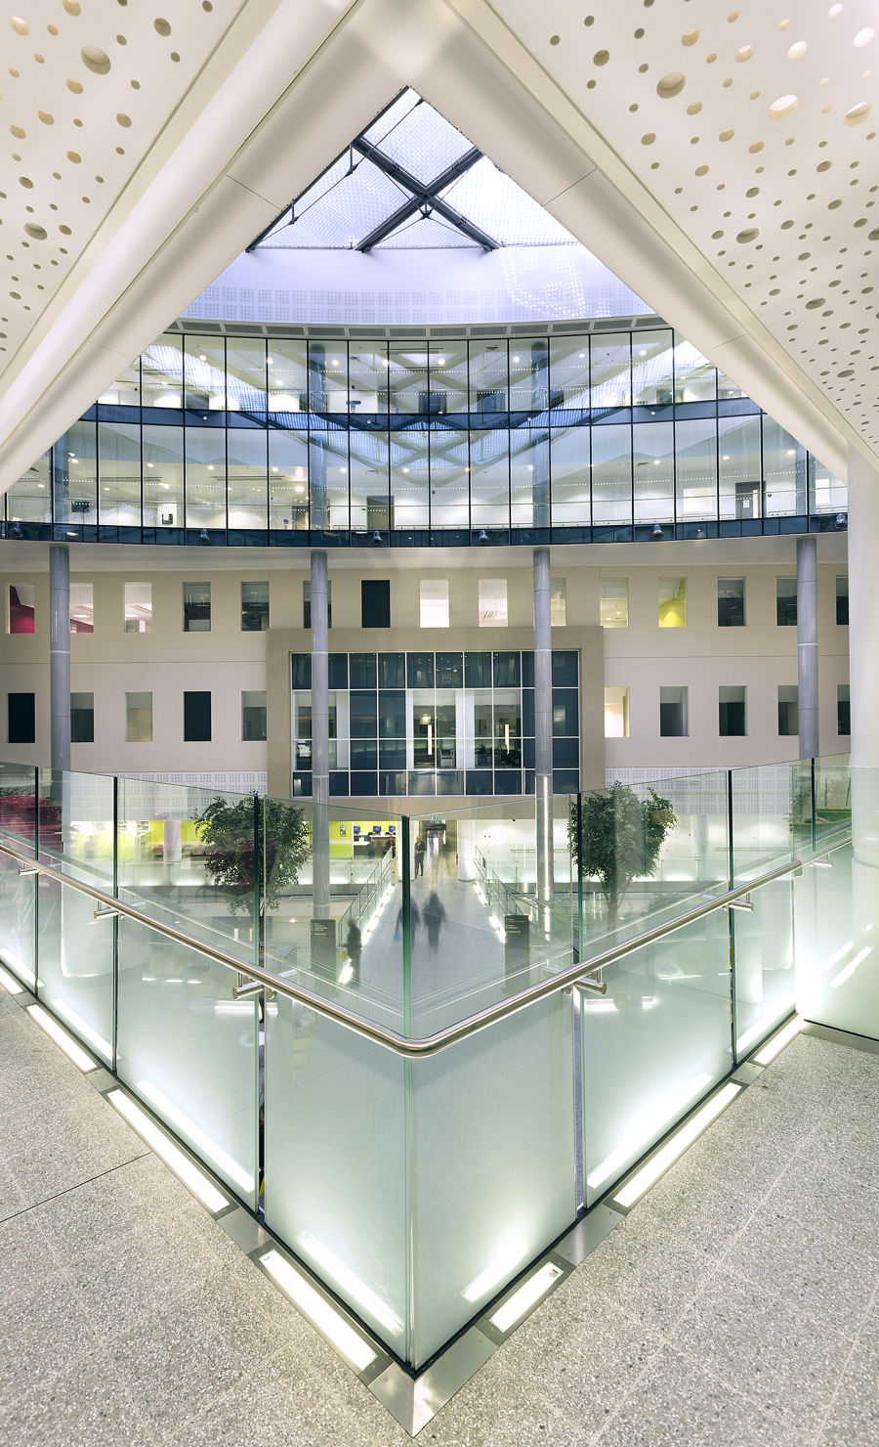
Barts AortoVascular Symposium 900
29th – 30th June 2023
RCP London
Further information: lorrainerichardson1@btinternet.com
077111 32946

